Slide 1
Strategic Planning Analysis
RLI - Part 2
Notes:
Begin the session:
Introduce self
Describe format for the session
Talk about what materials are available and/or where they can be found

Slide 2
Goals:
Analyze
Analyze Your Rotary Club
Review
Review Possible Areas of Improvement
Discuss
Discuss How to Make Specific Improvements
Understand
Understand Strategic Planning Process
Notes:
Review Session Goals, where this course fits into the Leadership curriculum of RLI
Quickly review Insert: SPA-1 “Good to Know for Strategic Planning and Analysis”

Slide 3

Self Evaluation
Think of a time when you experienced a self-evaluation
What was it like?
What was the process?
What was the result?
Was it successful?
Why or Why not?
Notes:
Introduce Warm-up Breakout activity by asking: Think of a time when you experienced a self-evaluation.
What was it like?
What was the process?
What was the result?
Was it successful?
Why or Why not”
Divide group into partners or trios
Refer SPA-1 Self Evaluation Document available in Documents for Class – My Event
Initiate Breakouts
Share the next Slide (Slide 4) to Breakouts to give participants an on-screen prompt.
When they return from the Breakout ask for one or two examples

Slide 4
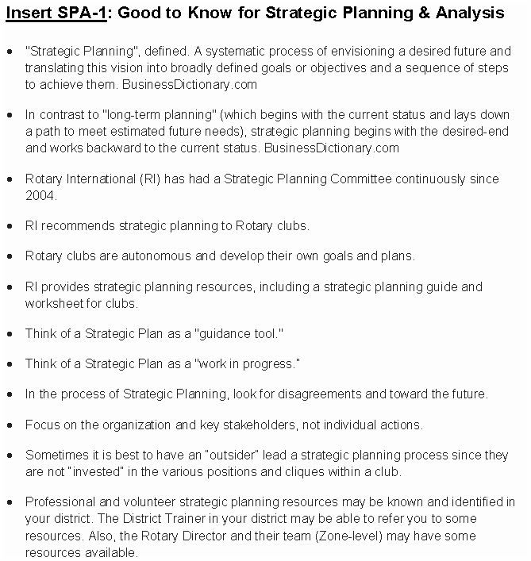
Self Evaluation
Think of a time when you experienced a self-evaluation
What was it like?
What was the process?
What was the result?
Was it successful?
Why or Why not?
Notes:
In order to share this slide to breakout rooms, you don’t need to stop sharing. Just hit the Share button again, and maker sure you click the option to “Share to Breakouts” along the right side of the screen. This option is not available until AFTER breakouts are started.
You may also “Broadcast” your voice to breakouts if you wish to give them more specific instructions, such as letting them know who is in each breakout. If you draw or mark anything on YOUR screen using Annotation Tools, they will also see that in the breakouts.
Note: If the person sharing (normally the Facilitator) joins a breakout, screen sharing will stop. For this reason, it may make sense to use a second computer to visit participants in breakouts, or to have the Producer share this slide to breakouts.

Slide 5
Evaluating Rotary
Rotary clubs and Rotarians can get into a rut, doing or not doing certain things out of habit. The process can give all involved an opportunity for readjustment or a fresh start. Participants may bring in their own experiences from work, education or other organizations to engage in evaluation processes and the importance of those experiences.
The exercise reinforces that the club leadership cares, their time is being used effectively, and their core mission of fellowship and service is important.
Notes:
Lead discussion about why self-evaluation of a Rotary club is important.
Rotary clubs and Rotarians can get in a rut, by doing (or not doing) certain things out of habit. The process can give all involved an opportunity for re-adjustment or a fresh start. Participants may bring in their own experiences from work, education, or other organizations to engage in evaluation processes and the importance of those experiences.
This exercise reinforces that the club leadership cares, their time is being used effectively and their core mission of fellowship and service is important. Let’s explore the questions:
1.) Why is a self-evaluation of a Rotary club important to the club?
2.) Why is it an important exercise within the club?
Discussion should include:
Is the club meeting members’ needs and expectations?
Is it effective in engaging the community?
Is it involving its members?
Is it using the Rotary menu of service opportunities?
Does it look and act like a Rotary club?

Slide 6
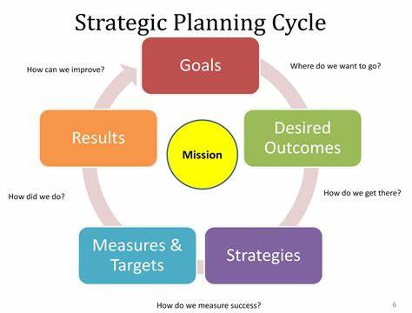
What is Strategic Planning?
It’s a Process
Look at the Environment
Formulate Objectives and Strategies
Develop Procedures to Implement
Evaluate the Process
Notes:
Draw the group’s attention to the visual depicting the Strategic Planning Process on the screen. (Also on page 8 of the Participant Manual)
Review the Strategic Planning Process including the following points:
Goals
Desired Outcomes
Strategies
Measures and Outcomes
Results
This process includes developing a plan for identifying and implementing long-term organizational goals.
Conduct an analysis to look at External and Internal Environment in which the organization (Rotary Club) finds itself
Formulate objectives and strategies based on an assessment of these environments
Develop procedures to implement and evaluate the strategic plan

Slide 7
How it Works?
What are your club’s ASSETS and LIABILITIES?
Into what CATEGORY does each fall?
Where are you NOW?
Where do you WANT TO BE in 3 years?
Make an ACTION PLAN
Notes:
Set up the Breakout Activity by providing them with the background and directions for their group activity.
The first step in the strategic planning process is to determine where you are. In your breakout groups share your respective clubs’ assets and liabilities. Then sort the liabilities into categories.
Among your group members choose one liability and work through the Strategic Planning Process.
Financial/Administrative
Membership
Service
Publicity
Foundation
In your group, describe where you (this club) are regarding that one issue. Brainstorm where you would like to be in one year regarding that one issue. Make a plan that lays out how you will get there. Determine the action plan for this issue by exploring the possible club assets.
Access SPA 2 and SPA 3 in Documents for Class to use as guides in Breakout groups.
Divide participants into groups of 3-6 people. Initiate Breakouts
Note: If the number of participants in this session is small, consider dividing the group in half with each group choosing a sample liability identified by one of the group members or choose a sample and have the whole group work together on it.

Slide 8
Breakout Activity
In your breakout groups share your respective clubs’ assets and liabilities. Then sort the liabilities into categories.
Among your group members choose one liability and work through the Strategic Planning Process.
  Financial/Administrative
  Membership
  Service
  Publicity
  Foundation
In your group, describe where you (this club) are regarding that one issue. Brainstorm where you would like to be in one year regarding that one issue. Make a plan that lays out how you will get there. Determine the action plan for this issue by exploring the possible club assets.
Notes:
In order to share this slide to breakout rooms, you don’t need to stop sharing. Just hit the Share button again, and maker sure you click the option to “Share to Breakouts” along the right side of the screen. This option is not available until AFTER breakouts are started.
You may also “Broadcast” your voice to breakouts if you wish to give them more specific instructions, such as letting them know who is in each breakout. If you draw or mark anything on YOUR screen using Annotation Tools, they will also see that in the breakouts.
Note: If the person sharing (normally the Facilitator) joins a breakout, screen sharing will stop. For this reason, it may make sense to use a second computer to visit participants in breakouts, or to have the Producer share this slide to breakouts.
The first step in the strategic planning process is to determine where you are. In your breakout groups share your respective clubs’ assets and liabilities. Then sort the liabilities into categories.
Among your group members choose one liability and work through the Strategic Planning Process.
Financial/Administrative
Membership
Service
Publicity
Foundation
In your group, describe where you (this club) are regarding that one issue. Brainstorm where you would like to be in one year regarding that one issue. Make a plan that lays out how you will get there. Determine the action plan for this issue by exploring the possible club assets.
Access SPA 2 and SPA 3 in Documents for Class to use as guides in Breakout groups.
Note: If the number of participants in this session is small, consider dividing the group in half with each group choosing a sample liability identified by one of the group members or choose a sample and have the whole group work together on it.

Slide 9
Do’s & Don’ts
DO Keep it Simple
DO Follow All Steps
Do Focus on the Mission
DO List ALL Ideas from the Team
DO Measure
DO Give Support
DON’T set Too Many Goals or get Too Detailed
DON’T skip Steps – They’re there for a Reason
DON’T do it because “We’ve Always Done It”
DON’T Jump into the Action until the Goals are Clear
DON’T skip the Evaluation
Notes:
Call for reports from breakout groups
Point out that the Strategic Planning Process often takes commitment on the part of leadership and should involve as many members as possible
Review the do’s and don’ts of good Strategic Planning as laid out on the slide
Direct group’s attention to Insert SPA-2 Rotary Club Self-Evaluation, page 10 Participant Manual.
Recommend participants use this tool or one like it with individual clubs to review current operations.

Slide 10
Rotary International Strategic Plan
Rotary’s Vision Statement TOGETHER we see a world where PEOPLE unite and take action to CREATE lasting CHANGE across the globe, in our communities and in ourselves
Rotary’s Strategic Priorities
Increase Our Impact
Expand Our Reach
Enhance Participant Engagement
Increase Our Ability to Adapt
Notes:
Compare the RI Strategic Plan (Insert SPA-4, page 23 Participant Manual) to a club’s strategic plan (or what you think your club’s strategic plan might include).
The mission of Rotary International is to provide service to others, promote integrity and advance world understanding, goodwill and peace through our fellowship of business, professional and community leaders.
The Rotary International New Strategic Plan has Four (4) Priorities.
Increase Our Impact
Expand Our Reach
Enhance Participant Engagement
Increase our Ability to Adapt
Each priority has several objectives (https://my.rotary.org/en/document/strategic-plan)
The guidance from Rotary International needs to be reflected in a club’s strategic plans.
Almost everything “Rotary” does is done by the clubs. However, RI’s mission is to help support clubs, focus, and increase humanitarian service and enhance public image and awareness. These are shared emphases meant to make Rotary clubs stronger and more effective individually and thereby make Rotary stronger by their collective action and unified focus.
The RI Strategic Plan can be used as a resource in the club strategic planning process, so that the planning club can do those things that Rotary International believes will make them successful and add to the success of Rotary worldwide.
Conclude by brainstorming with participants how they can use this information in beginning the strategic planning process in their home clubs.

